Slide 1
St. Louis Central Corridor West Building Permits
Monthly Report: January 2020 Washington University Medical Center

Slide 2
Introduction
Data retreived from https://www.stlouis-mo.gov/data/
Building permits with a cost of $0 were dropped
Building permits that were cancelled were dropped

Slide 3
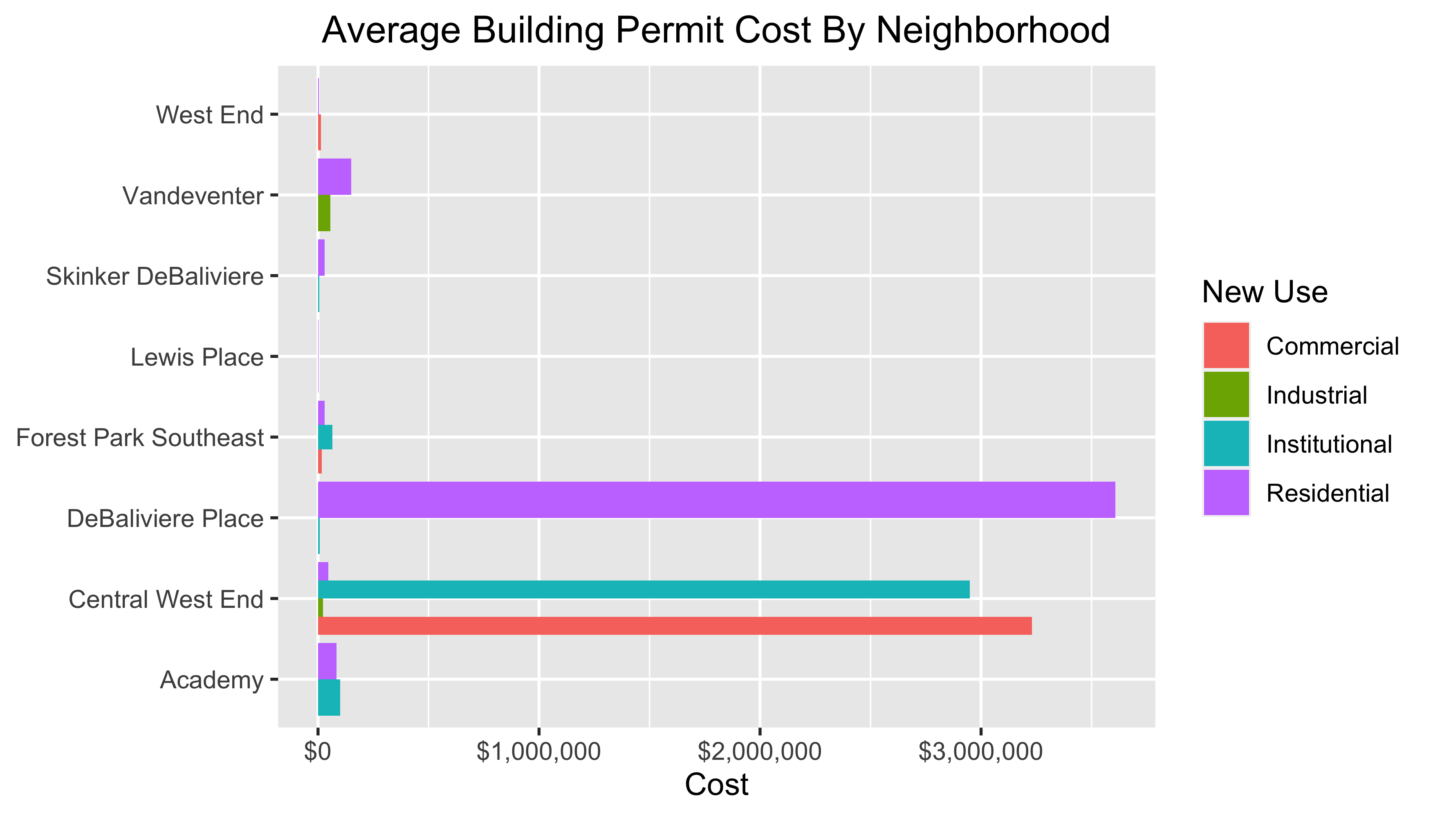
Neighborhood Summary

Slide 4
#create in depth summary table df%>% group_by(nbhd_name)%>% summarize(mean = mean(EstProjectCost), count = n())%>% select(nbhd_name, mean, count) -> table #make a currency value table$mean <- currency(table$mean, digits = 0L) #print summary table knitr::kable(table, col.names = c("Neighborhood", "Average Cost", "Permit Count"), format="markdown", caption = "Neighborhood Summary")

Slide 5
Neighborhood | Average Cost | Permit Count
Academy | $85,825 | 6
Central West End | $1,783,365 | 36
DeBaliviere Place | $4,512,000 | 4
Forest Park Southeast | $44,015 | 9
Lewis Place | $2,500 | 1
Skinker DeBaliviere | $27,571 | 7
Vandeventer | $102,500 | 2
West End | $8,000 | 10

Slide 6
Forest Park Southeast
9 building permits in Forest Park Southeast in January 2020

Slide 7
New Use | Average Cost | Permit Count
Commercial | $17,500 | 2
Institutional | $64,145 | 1
Residential | $49,498 | 6

Slide 8
Owner | New Use | Cost | Address
MITCHELL, TIMOTHY J | Residential | $3,000 | 4535 OAKLAND AV
ROBBINS, ARNOLD J & TERRIE L | Residential | $250,000 | 4353 HUNT AV
ALBIN, MICHAEL & LISA | Residential | $3,990 | 4227 SWAN AV
TISOTO, JEFFREY & LYNNE | Commercial | $15,000 | 4523 GIBSON AV
WASHINGTON UNIVERSITY | Institutional | $64,145 | 1234 S KINGSHIGHWAY BLVD
VITT, VICTOR J JR | Residential | $9,000 | 4366 HUNT AV
4176 MANCHESTER LLC | Commercial | $20,000 | 4176 MANCHESTER AV
KAMPE, NICHOLAS R | Residential | $30,000 | 4448 CHOUTEAU AV
JOHNSON, ISAIAH & CALLIE | Residential | $1,000 | 4327 GIBSON AV

Slide 9
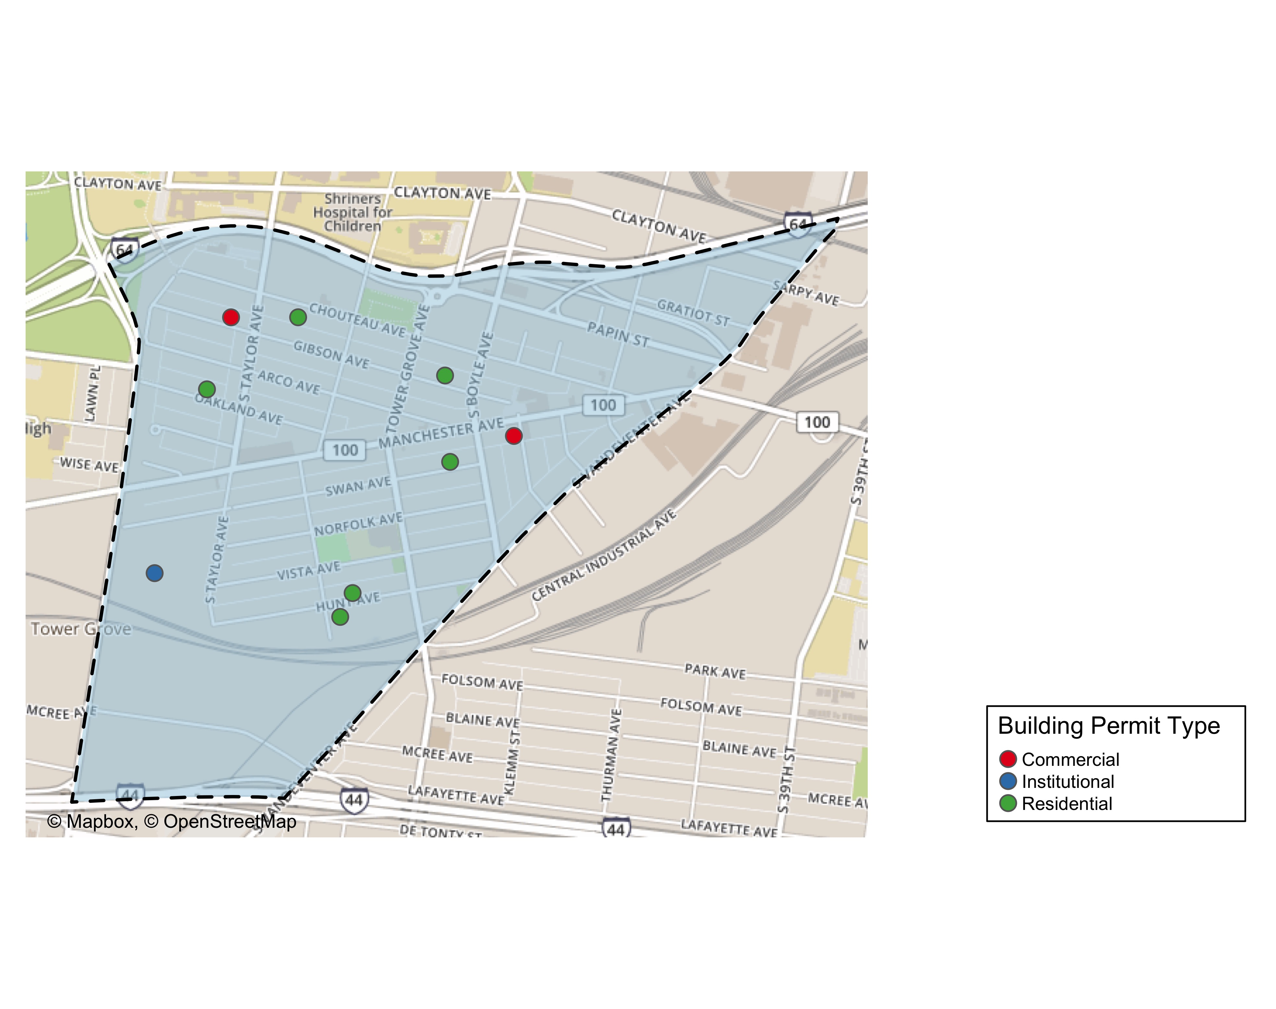

Slide 10
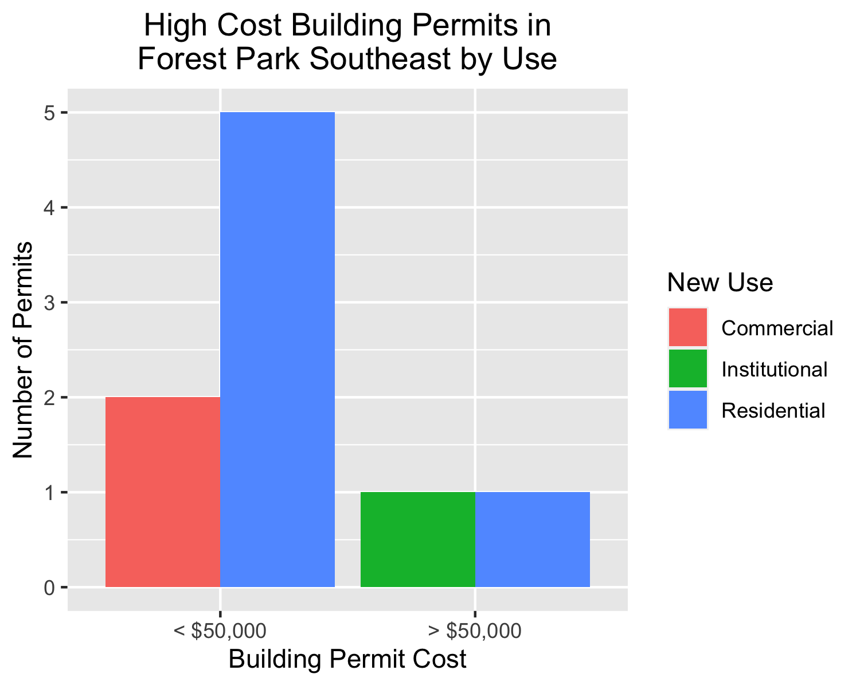

Slide 11
Central West End
36 building permits in Central West End in January 2020

Slide 12
New Use | Average Cost | Permit Count
Commercial | $4,037,500 | 4
Industrial | $21,676 | 1
Institutional | $3,629,497 | 13
Residential | $47,000 | 18

Slide 13
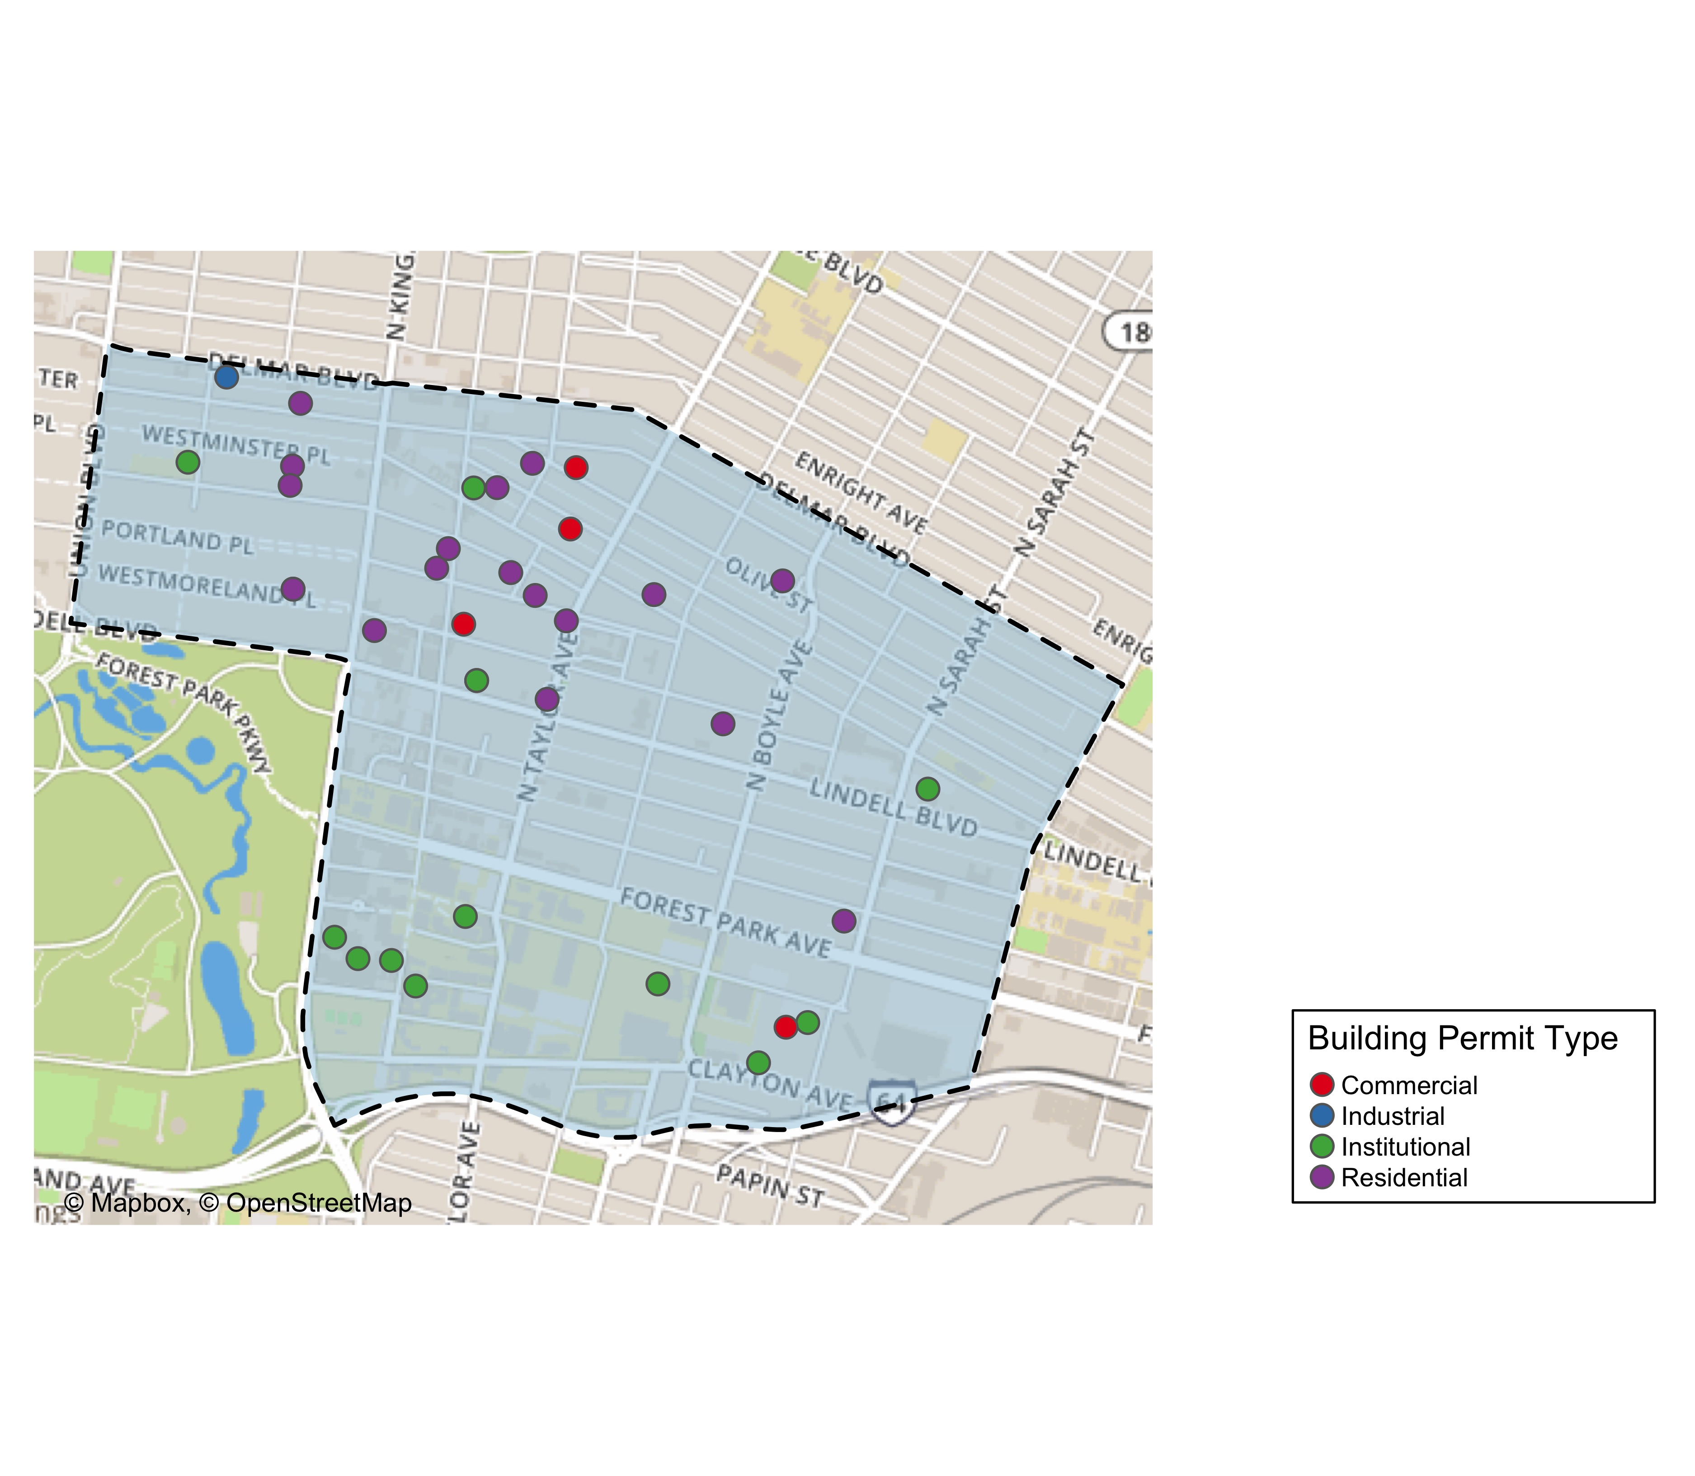

Slide 14
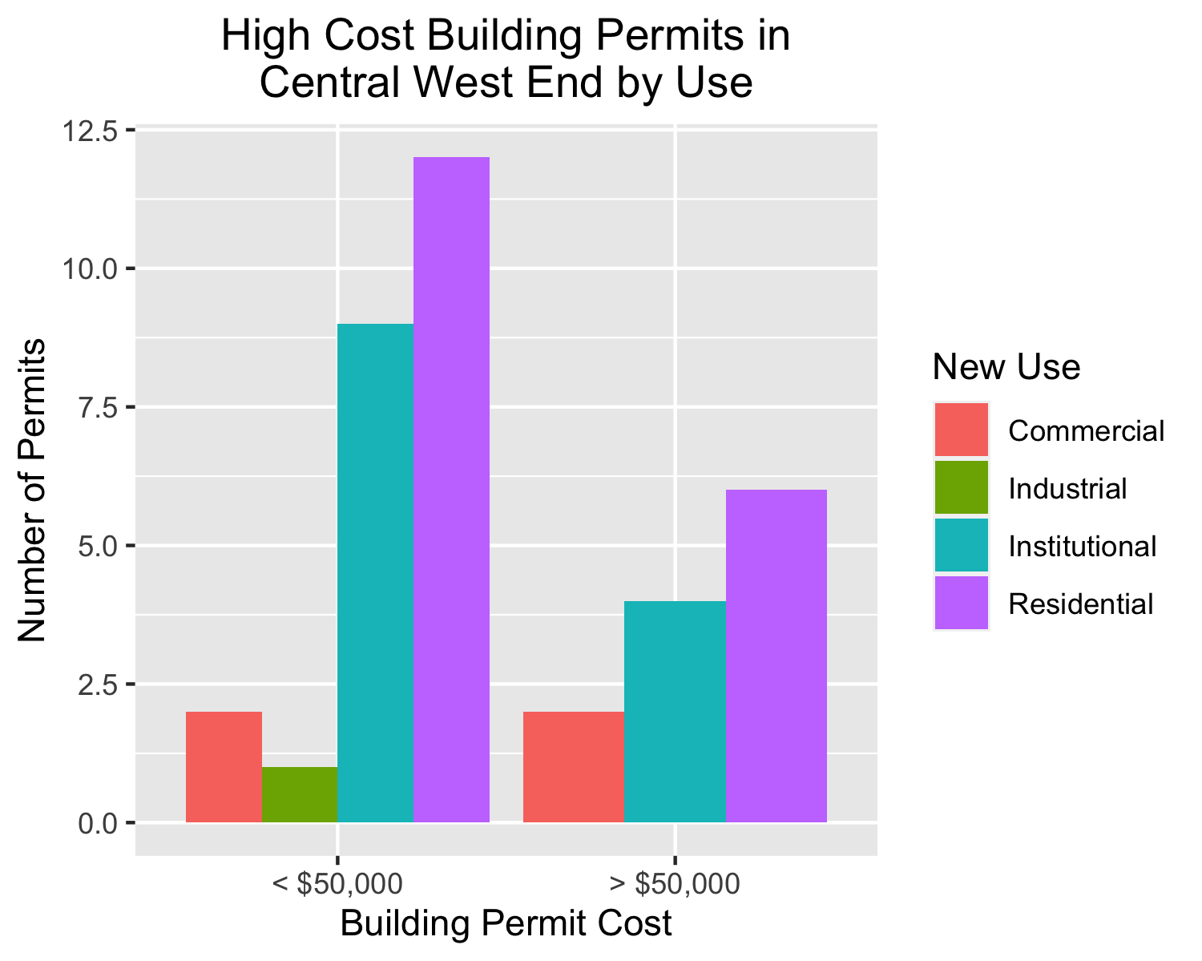

Slide 15
DeBaliviere Place
4 building permits in DeBaliviere Place in January 2020

Slide 16
New Use | Average Cost | Permit Count
Institutional | $8,000 | 1
Residential | $6,013,333 | 3

Slide 17
Owner | New Use | Cost | Address
DEL MONTE APARTMENTS LLC | Institutional | $8,000 | 5622 DELMAR BLVD
CALHOUN, BARRY & SHIRA SPETNER | Residential | $5,000 | 10 WASHINGTON TER
REDIGER, DOUGLAS HTRS | Residential | $35,000 | 5373 LINDELL BLVD
KILAMANJARO V LLC | Residential | $18,000,000 | 5637 PERSHING AV

Slide 18
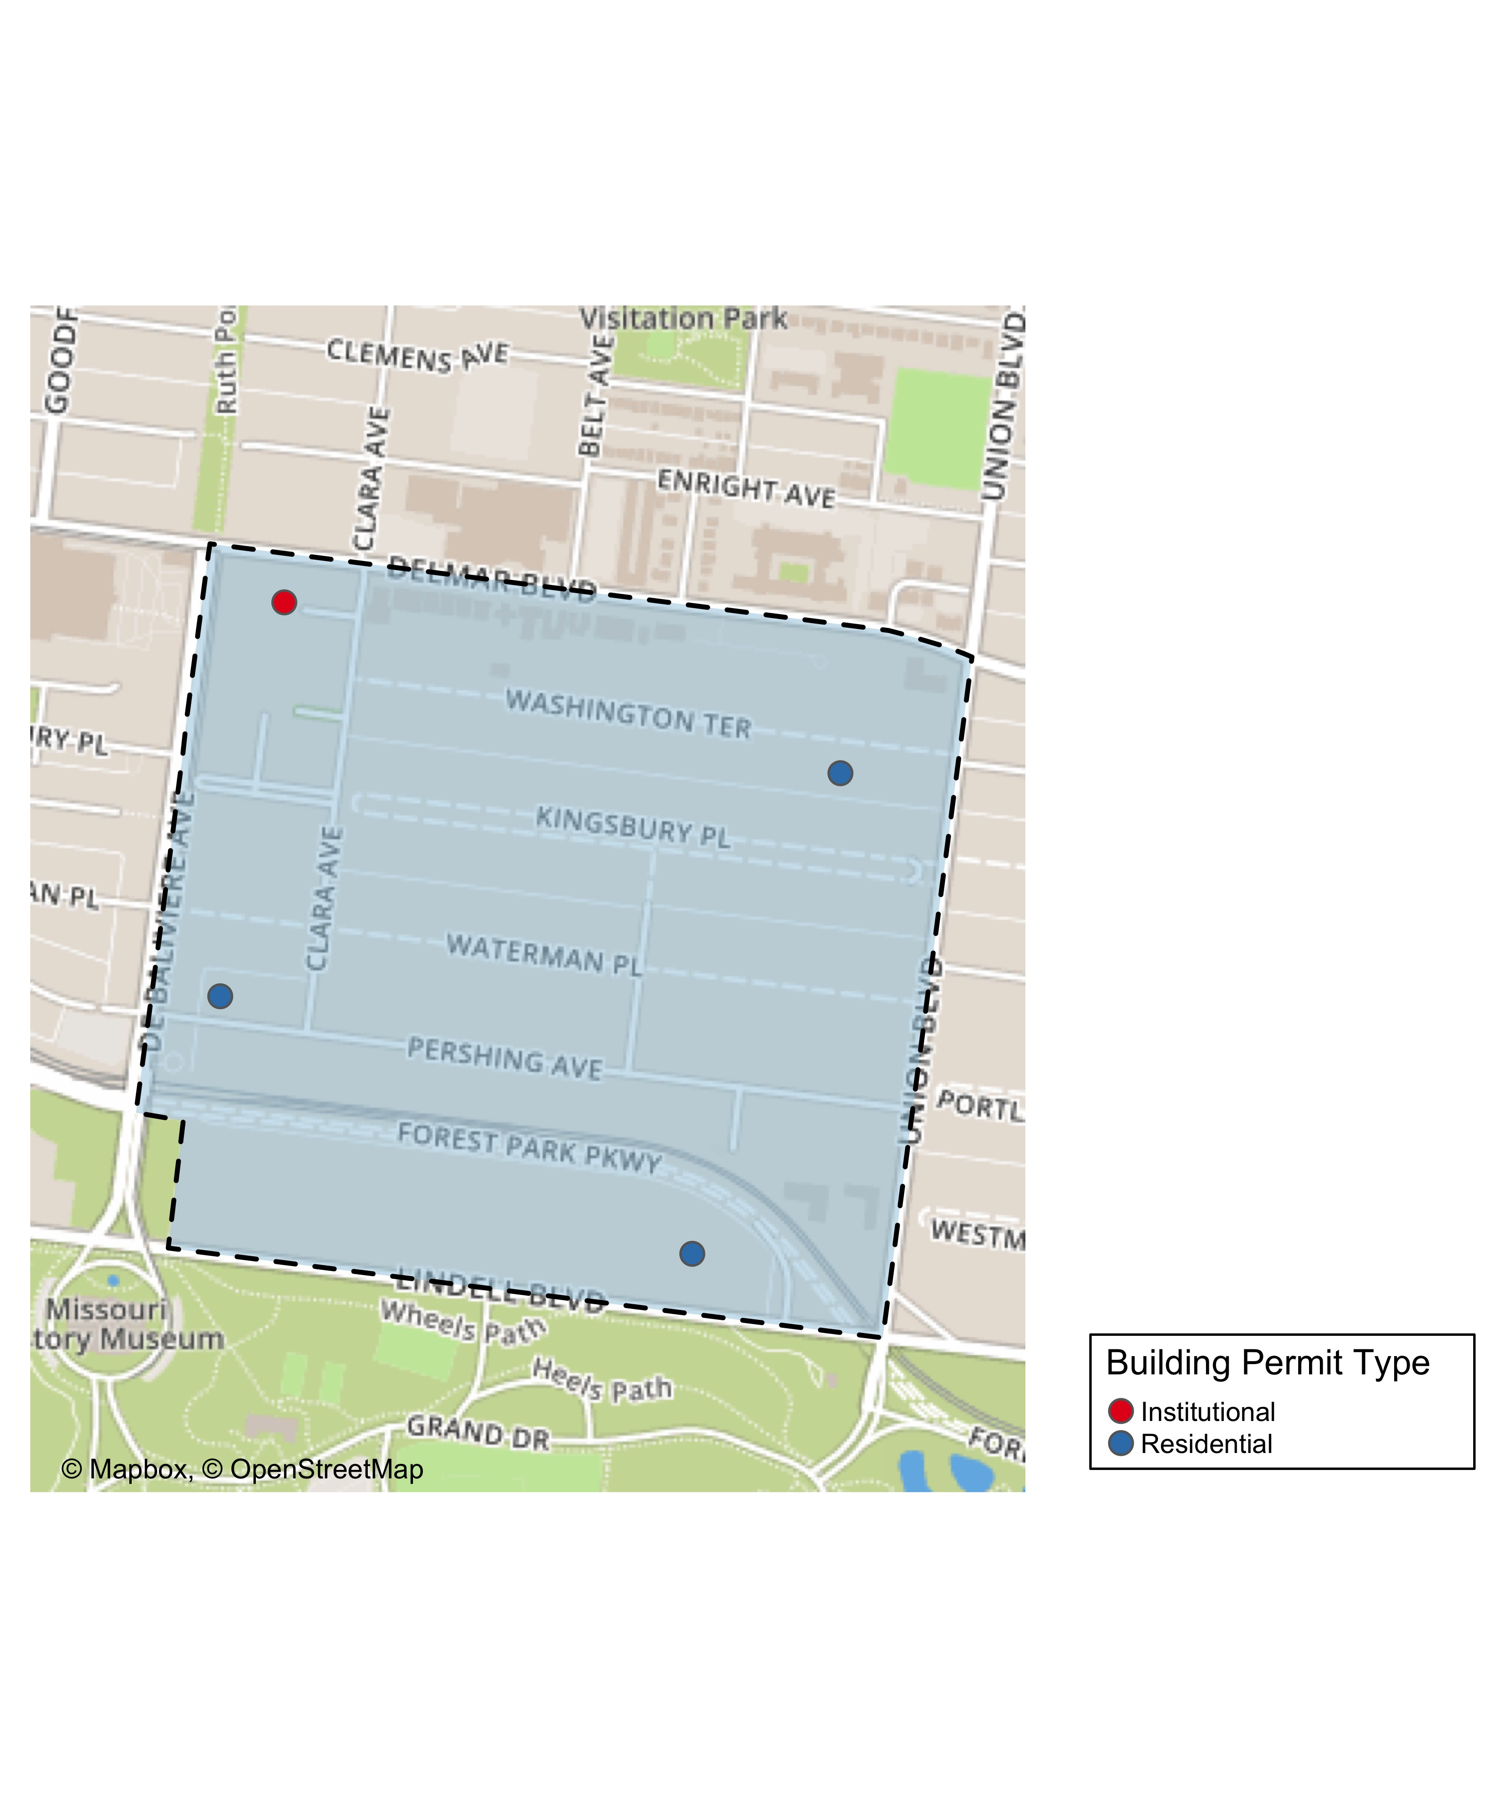

Slide 19
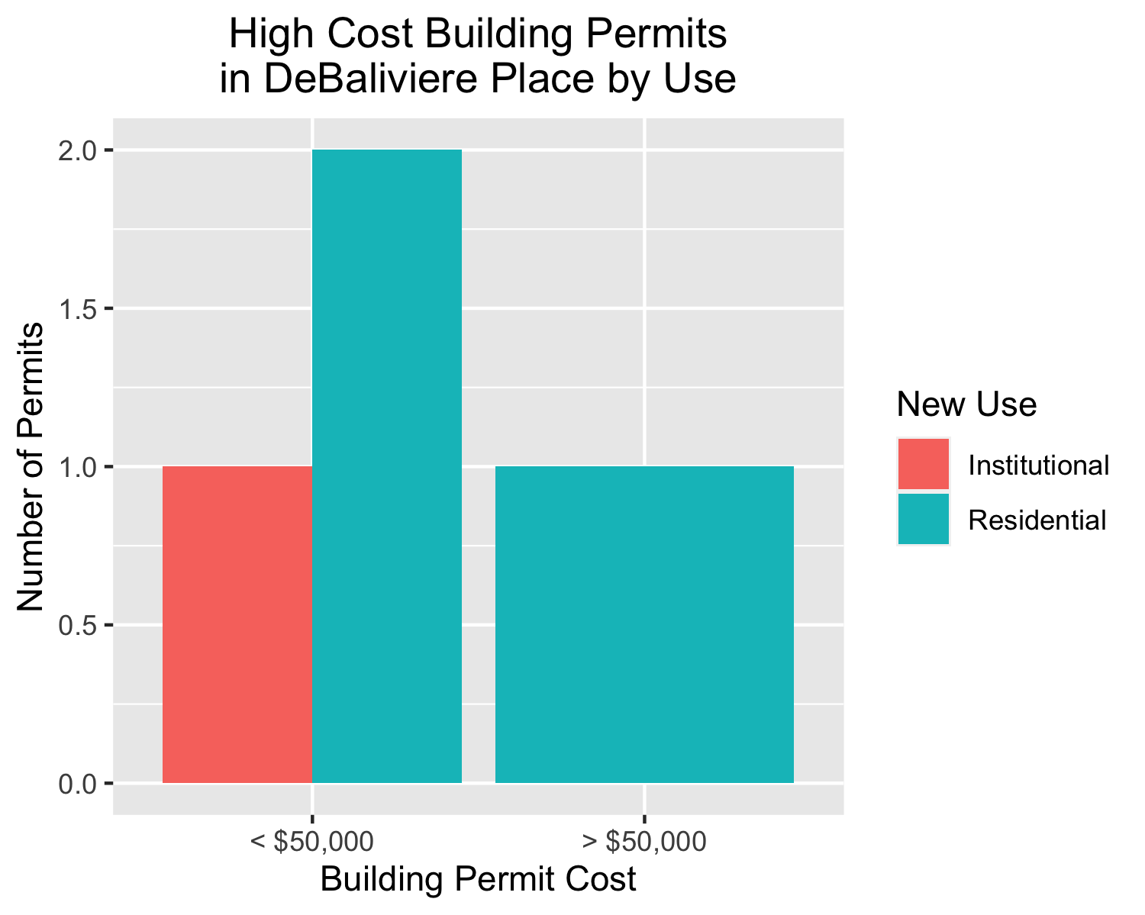

Slide 20
Skinker DeBaliviere
7 building permits in Skinker DeBaliviere in January 2020

Slide 21
New Use | Average Cost | Permit Count
Institutional | $10,000 | 1
Residential | $30,500 | 6

Slide 22
Owner | New Use | Cost | Address
WASHINGTON UNIVERSITY ART BUILDING | Institutional | $10,000 | 6220 FOREST PARK PARKWAY
DEE, MICHAEL PATRICK & | Residential | $76,500 | 6232 MCPHERSON AV
HOFFMAN, CHERI L | Residential | $27,000 | 6211 WESTMINSTER PL
WELCH, MARGARET & MARY LOU | Residential | $17,500 | 6189 KINGSBURY AV
ONE WORLD - USA, LLC | Residential | $33,000 | 5948 PERSHING AV
ONE WORLD - USA, LLC | Residential | $14,000 | 5948 PERSHING AV
DEE, MICHAEL PATRICK & | Residential | $15,000 | 6232 MCPHERSON AV

Slide 23
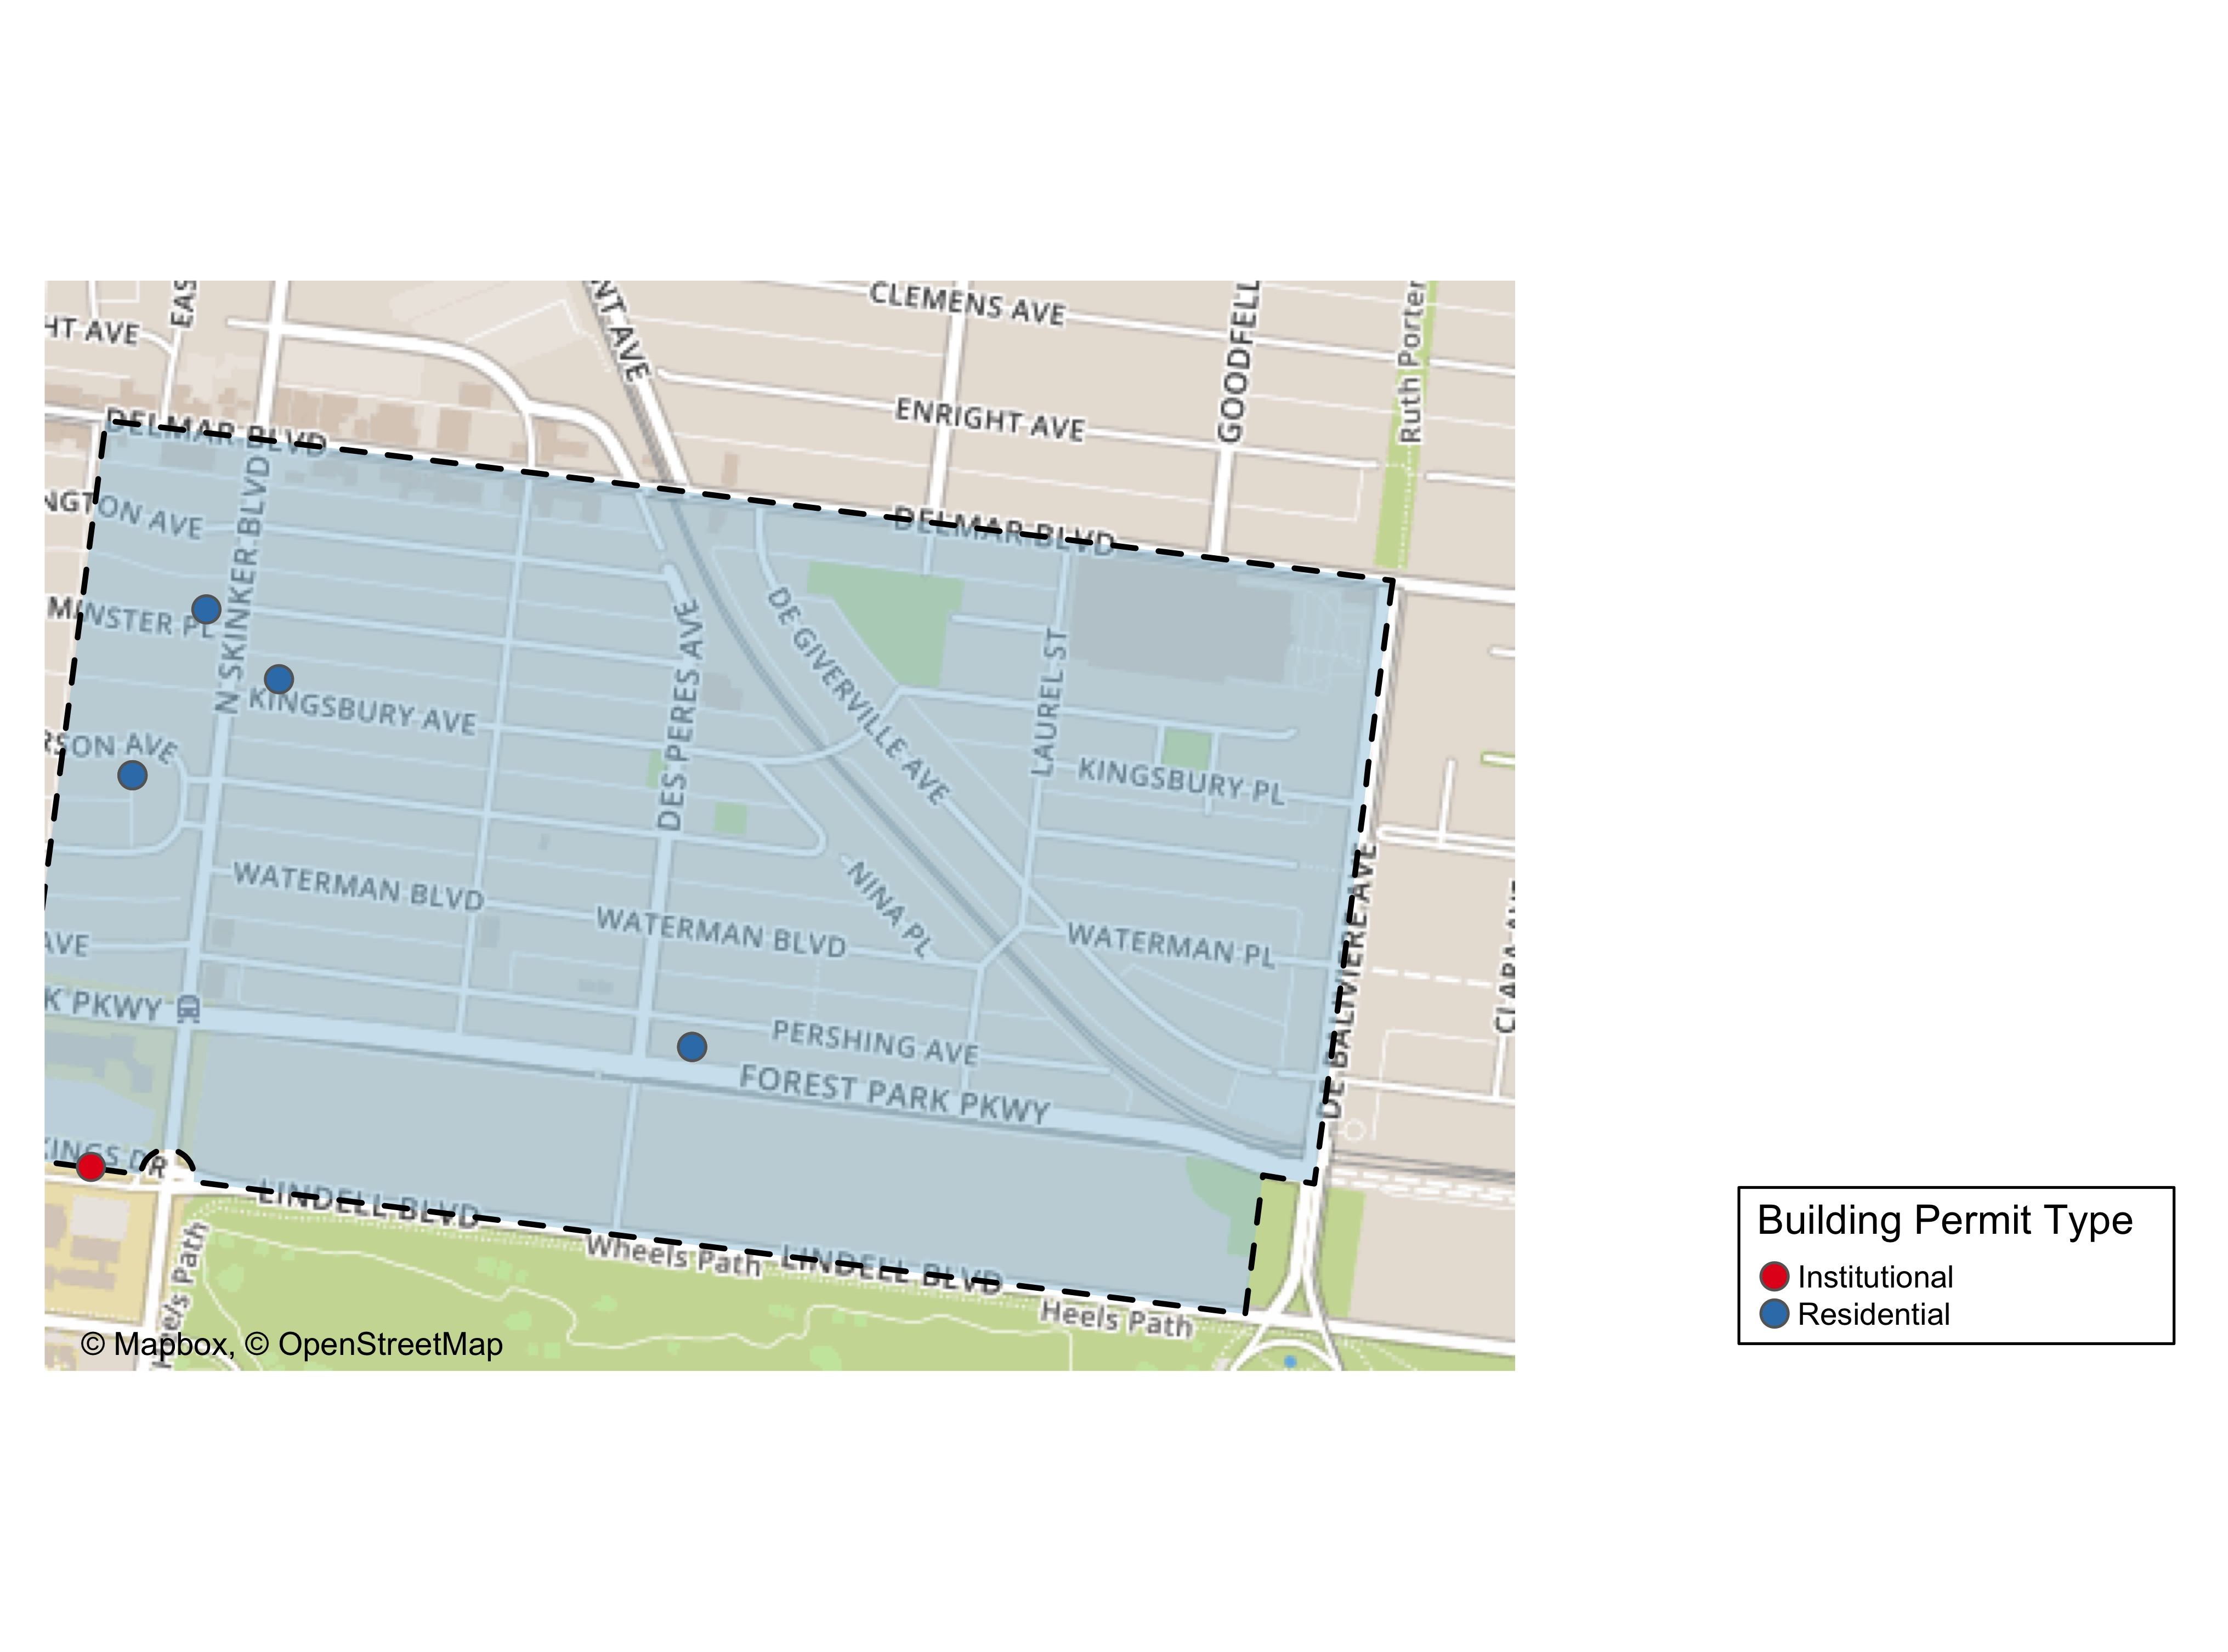

Slide 24
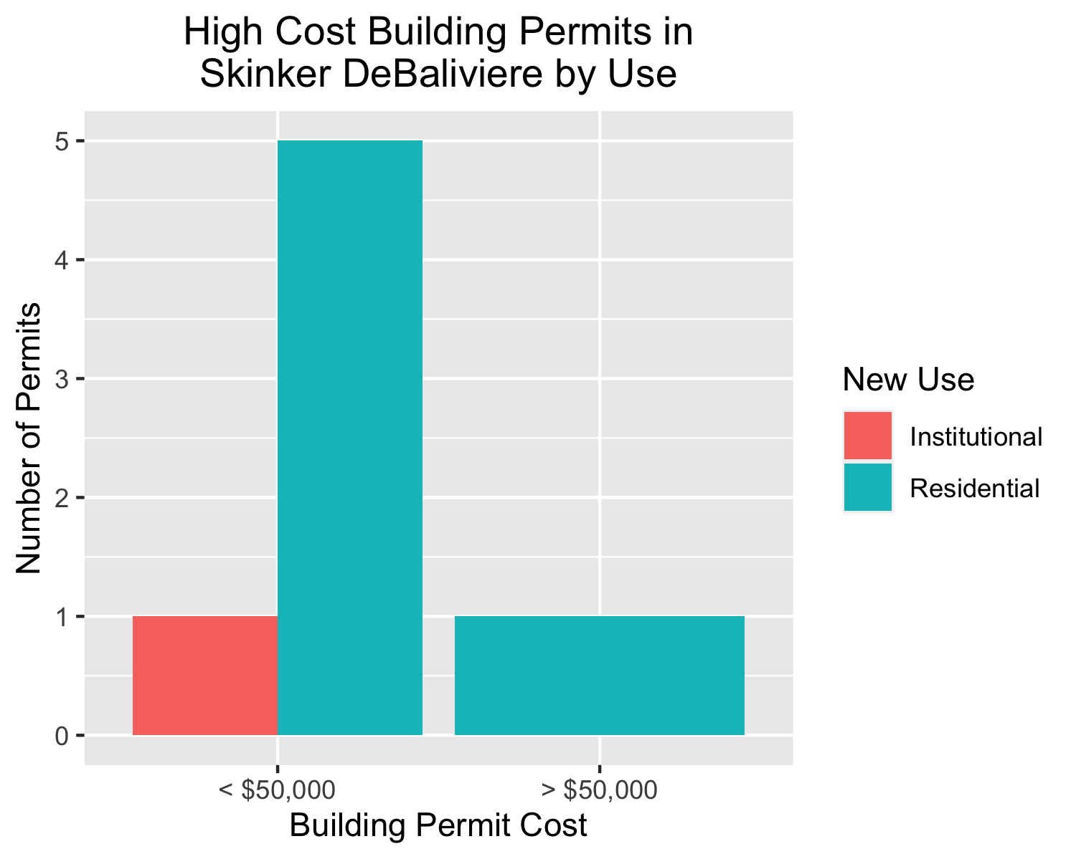

Slide 25
West End
10 building permits in West End in January 2020

Slide 26
New Use | Average Cost | Permit Count
Commercial | $21,000 | 2
Residential | $4,750 | 8

Slide 27
Owner | New Use | Cost | Address
KEY MASTERS LLC | Residential | $2,000 | 5647 VERNON AV
THREE DOORS PROPERTIES LLC | Residential | $30,000 | 6018 HORTON PL
WESTEND CATES LLC | Residential | $1,000 | 6062 CATES AV
WESTEND CHAMBERLAIN LLC | Residential | $1,000 | 5561-5565 CHAMBERLAIN AV
WESTEND CHAMBERLAIN LLC | Residential | $1,000 | 5569-5571 CHAMBERLAIN AV
WESTEND HAMILTON LLC | Residential | $1,000 | 5902-5906 HORTON PL
WESTEND HAMILTON LLC | Residential | $1,000 | 1019-1021 HAMILTON AV
WESTEND HAMILTON LLC | Residential | $1,000 | 1023-1025 HAMILTON AV
PACE-DELMAR ASSOCIATES LLC | Commercial | $32,000 | 6211 DELMAR BLVD
PACE-DELMAR ASSOCIATES LLC | Commercial | $10,000 | 621 N SKINKER BLVD

Slide 28
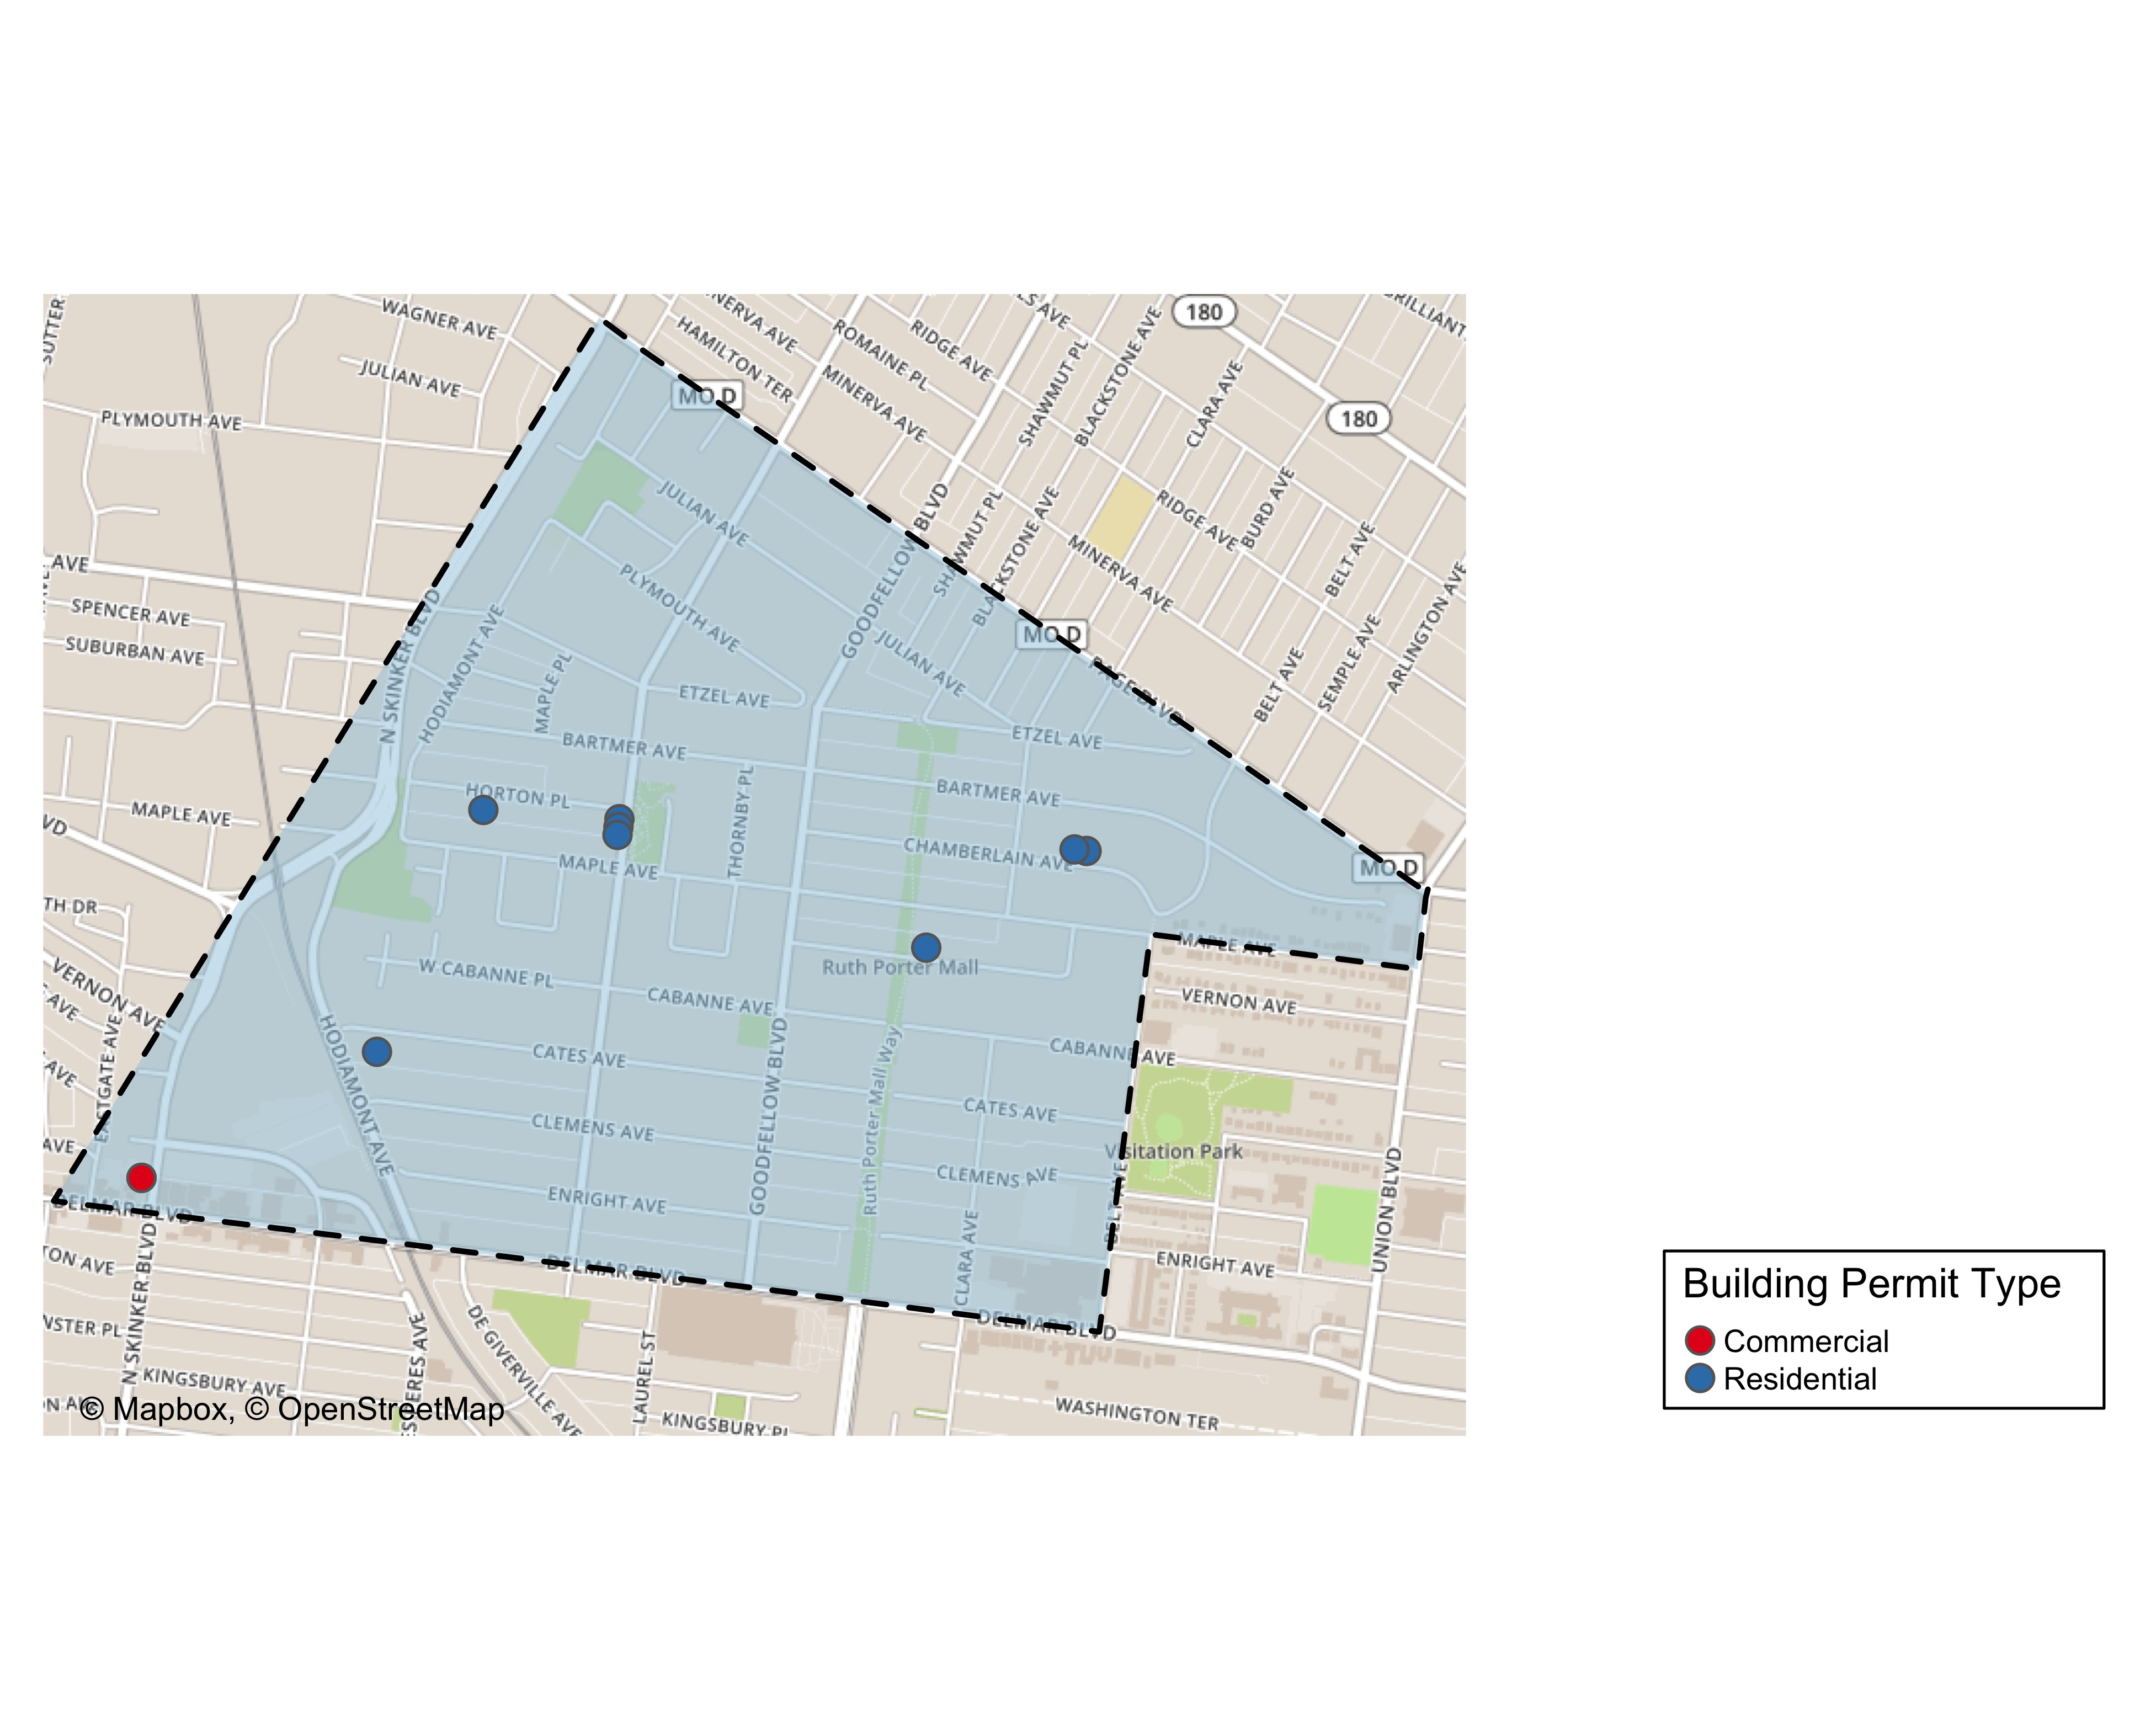

Slide 29
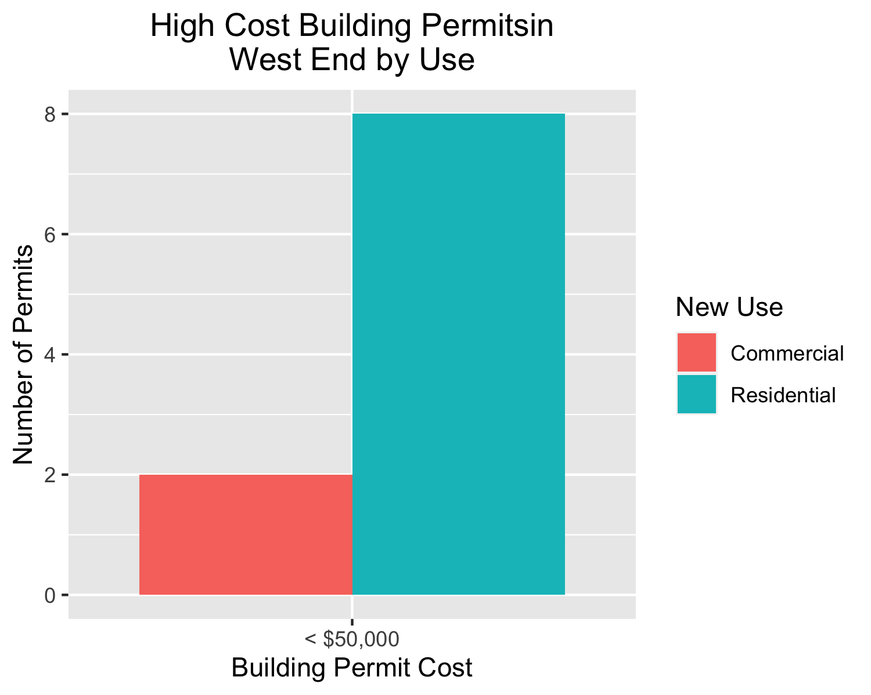

Slide 30
Visitation Park
0 building permits in Visitation Park in January 2020

Slide 31
Academy
6 building permits in Academy in January 2020

Slide 32
New Use | Average Cost | Permit Count
Institutional | $100,000 | 1
Residential | $82,990 | 5

Slide 33
Owner | New Use | Cost | Address
MCCLENDON, GARY & GENA | Residential | $1,500 | 5021 MINERVA AV
GREEN LINE LLC | Residential | $200,000 | 5169 ENRIGHT AV
GREEN LINE LLC | Residential | $200,000 | 5167 ENRIGHT AV
MURPHY, CHRISTINA | Residential | $8,450 | 5101 CABANNE AV
ELDER, O TERRY | Institutional | $100,000 | 813 N KINGSHIGHWAY BLVD
JONES, ELLA M | Residential | $5,000 | 5207 RIDGE AV

Slide 34
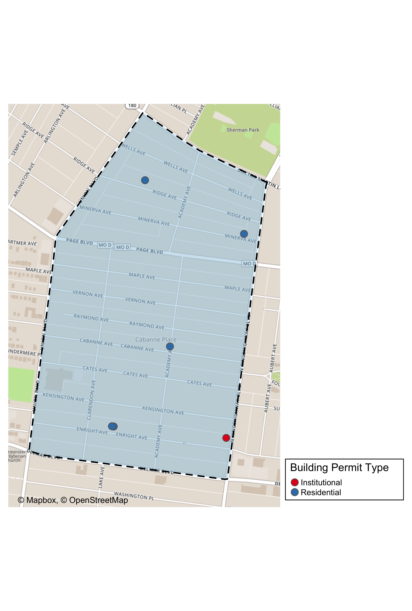

Slide 35
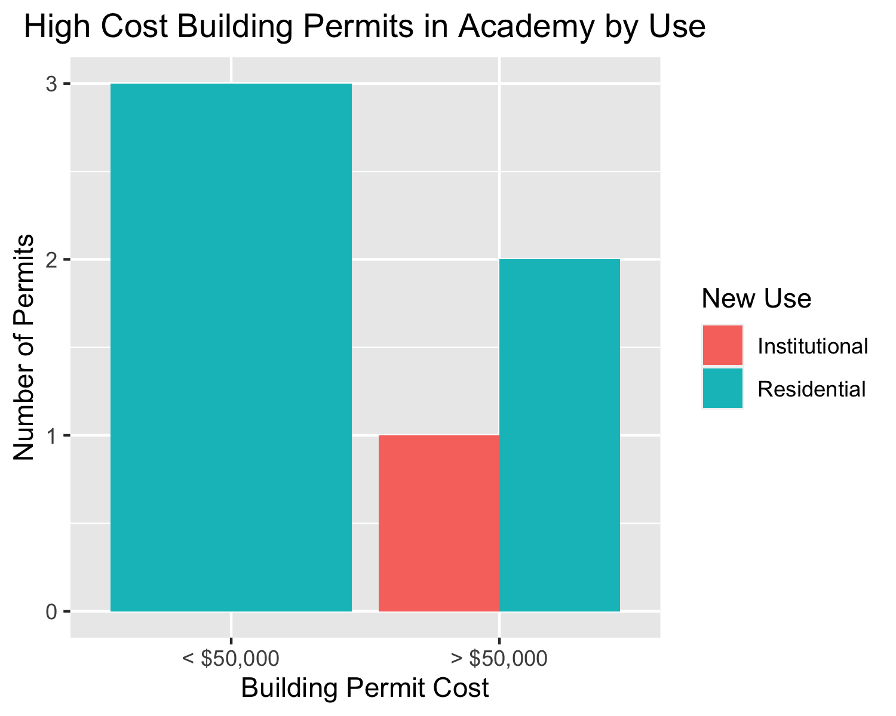

Slide 36
Fountain Park
0 building permits in Fountain Park in January 2020

Slide 37
Lewis Place
1 building permits in Lewis Place in January 2020

Slide 38
New Use | Average Cost | Permit Count
Residential | $2,500 | 1

Slide 39
Owner | New Use | Cost | Address
GRAVES, JOHN E | Residential | $2,500 | 4727 PAGE BLVD

Slide 40
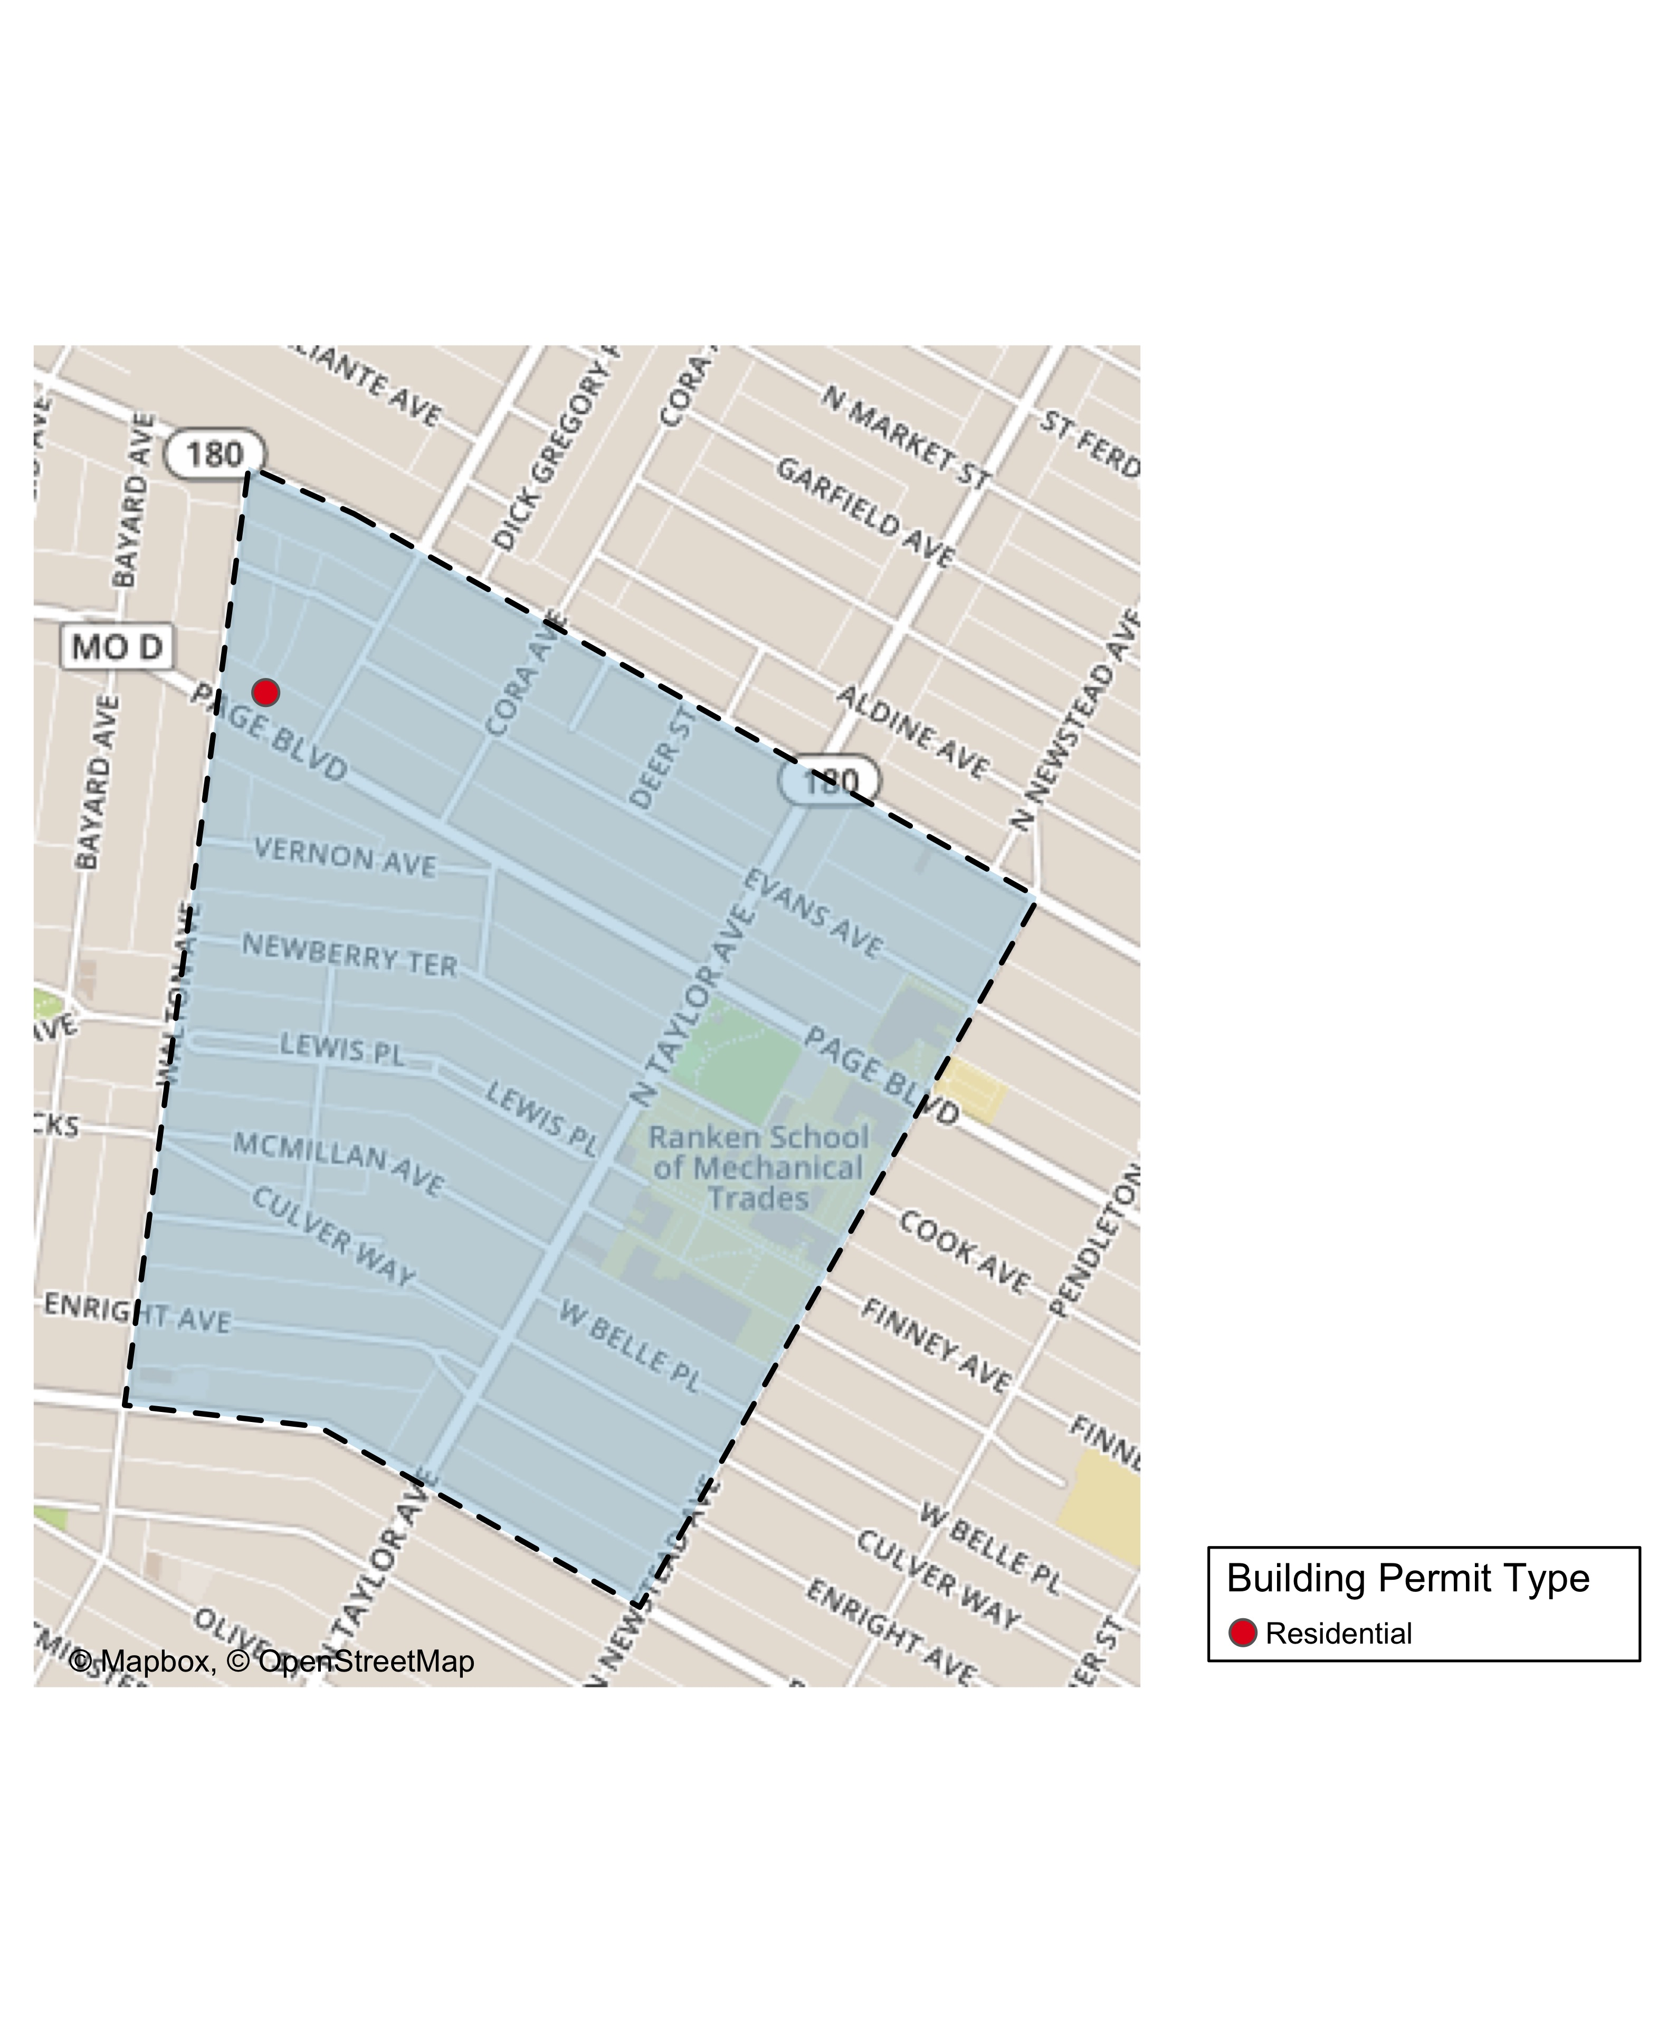

Slide 41
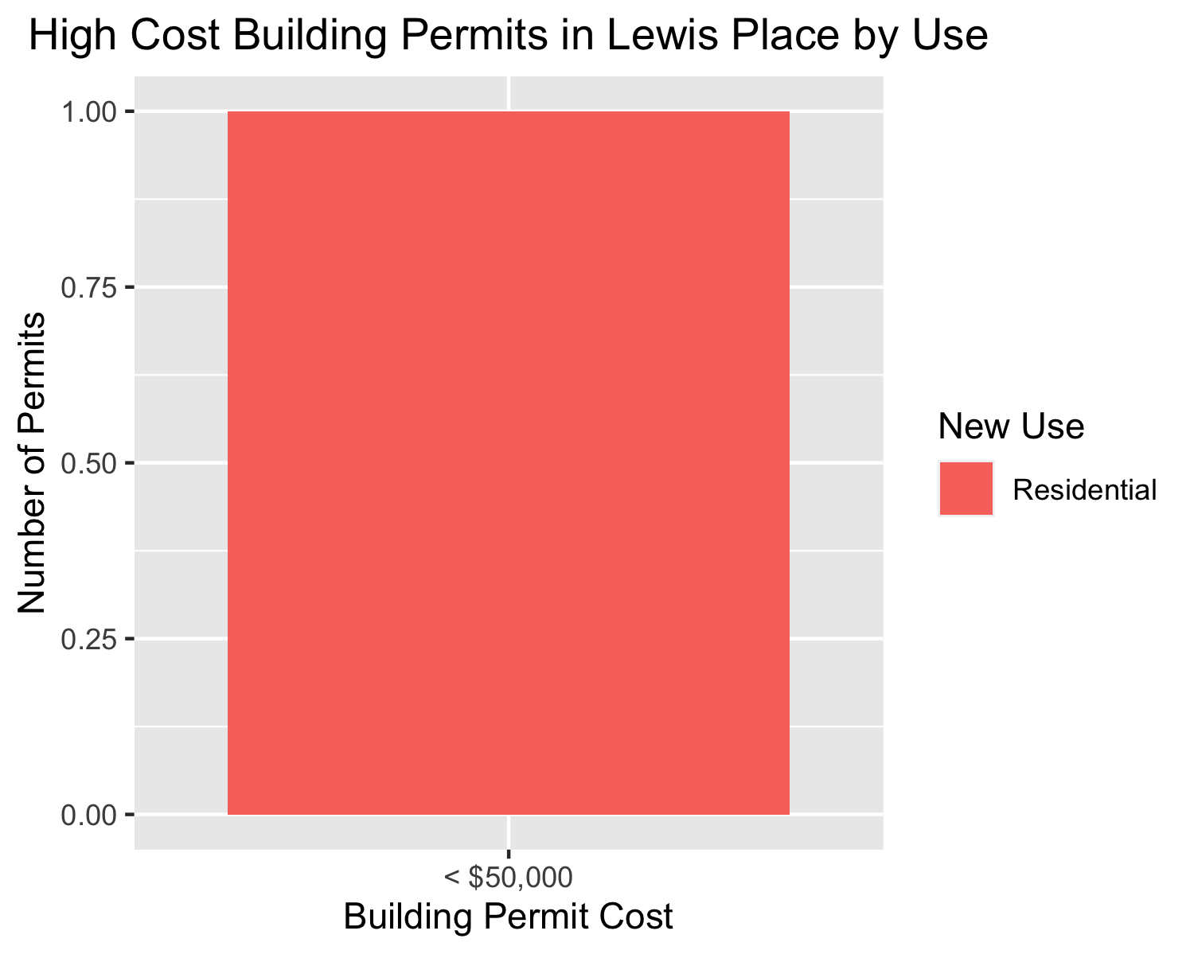

Slide 42
Vandeventer
2 building permits in Vandeventer in January 2020

Slide 43
New Use | Average Cost | Permit Count
Industrial | $55,000 | 1
Residential | $150,000 | 1

Slide 44
Owner | New Use | Cost | Address
LOTT, JAMALIA | Residential | $150,000 | 4050 ENRIGHT AV
BROWN, TONY C SR & SHARON D BROWN | Industrial | $55,000 | 3960-66 PAGE BLVD

Slide 45
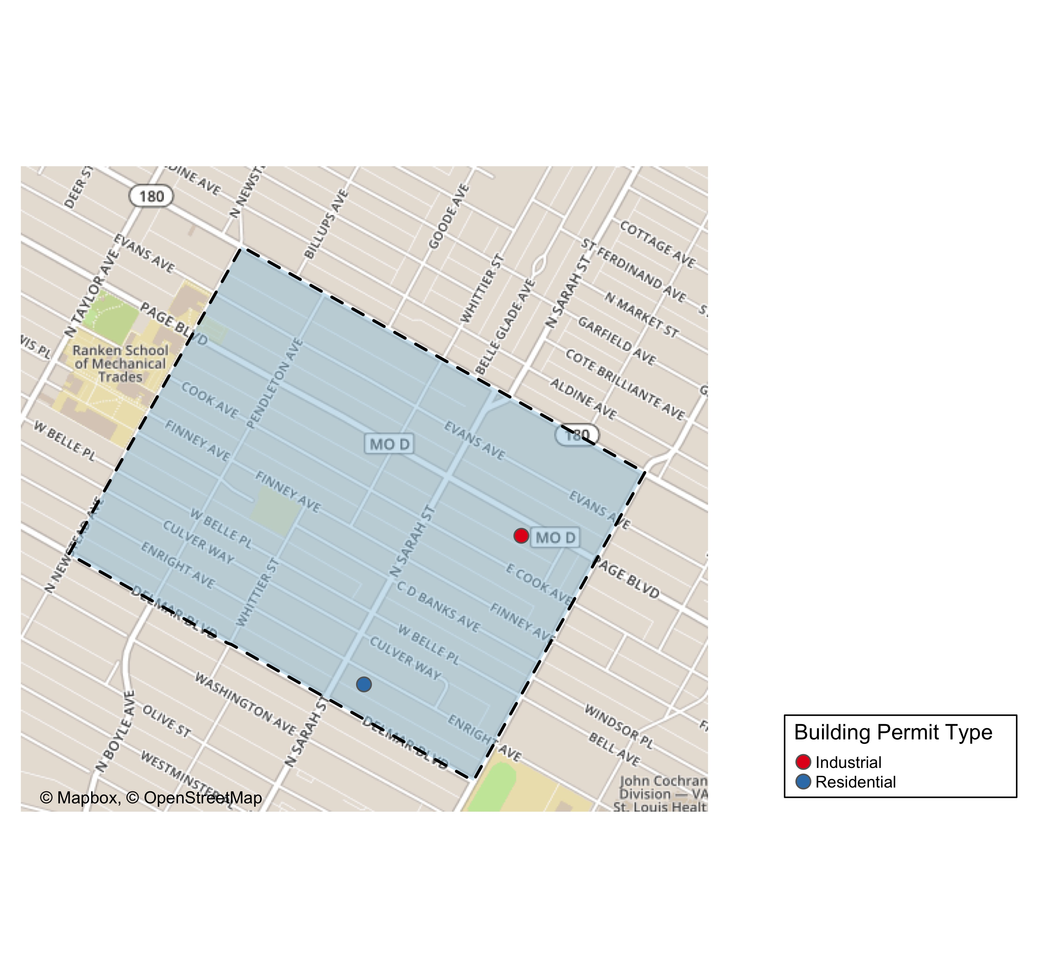

Slide 46
